Slide 1

Chapter 2: Overview of the UML Notation

Slide 2
Contents
1. UML DIAGRAMS
2. USE CASE DIAGRAMS
3. CLASSES AND OBJECTS
4. CLASS DIAGRAMS
5. INTERACTION DIAGRAMS
6. STATE MACHINE DIAGRAMS
7. PACKAGES
8. CONCURRENT COMMUNICATION DIAGRAMS
9. DEPLOYMENT DIAGRAMS
10. UML EXTENSION MECHANISMS
10. CONVENTIONS USED IN THIS BOOK

Slide 3
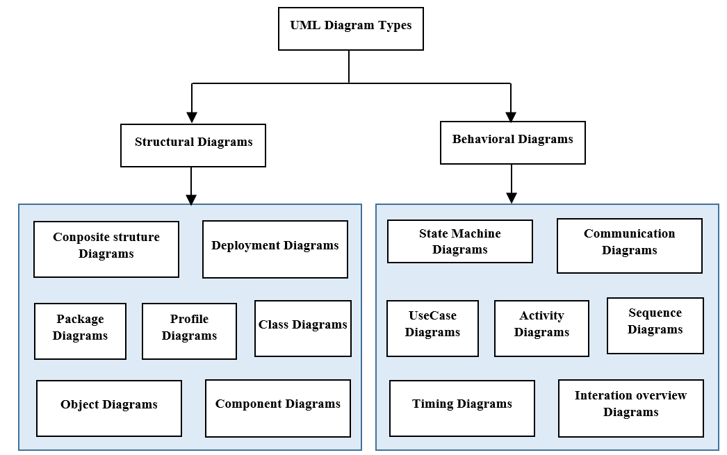
1. UML DIAGRAMS

Slide 4
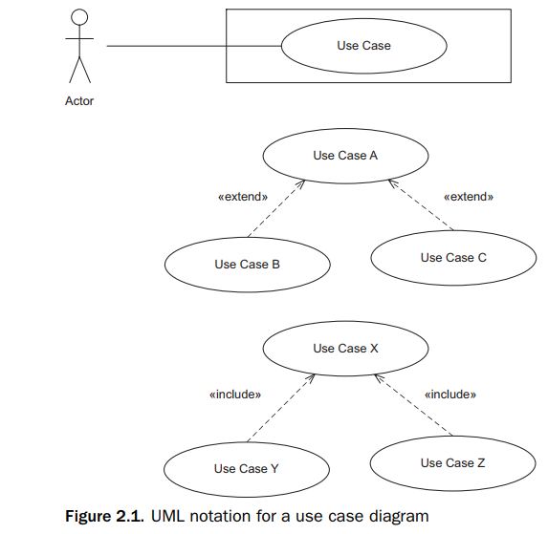
2. Use case diagrams
An actor initiates a use case.
A use case defines a sequence of interactions between the actor and the system.

Slide 5
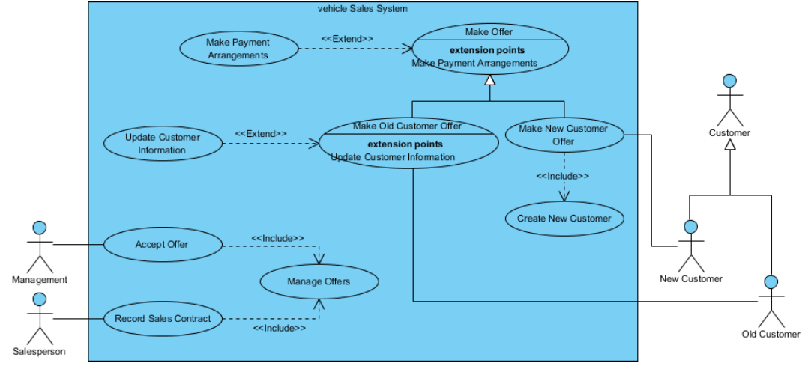
2. Use case diagrams

Slide 6
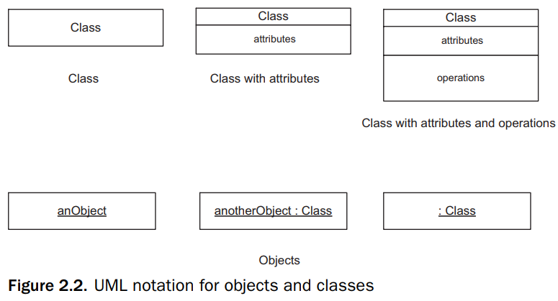
3. Classes and objects
To distinguish between a class (the type) and an object (an instance of the type), an object name is shown underlined.
An object can be depicted in full with the object name separated by a colon from the class name

Slide 7
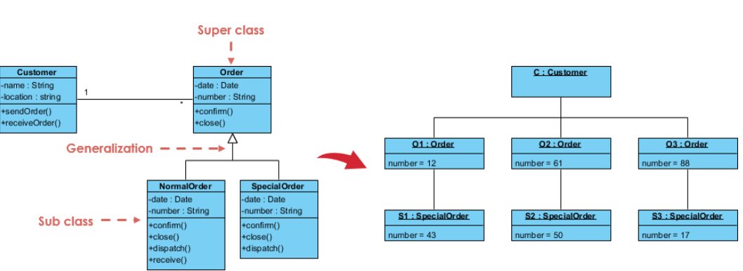
3. Classes and objects

Slide 8
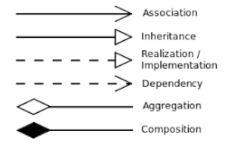
4. Classes diagrams
In a class diagram, classes are depicted as boxes, and relationships are depicted as lines connecting the boxes.
There are six main types of relationships between classes: inheritance , realization / implementation , composition , aggregation , association, and dependency.

Slide 9
4. Classes diagrams
Visibility refers to whether an element of the class is visible from outside the class:
Public visibility, denoted with a + symbol, means that the element is visible from outside the class.
Private visibility, denoted with a – symbol, means that the element is visible only from within the class that defines it and is thus hidden from other classes.
Protected visibility, denoted with a # symbol, means that the element is visible from within the class that defines it and within all subclasses of the class.

Slide 10
5. Interaction diagrams
UML has two main kinds of interaction diagrams, which depict how objects interact: the communication diagram and the sequence diagram

Slide 11
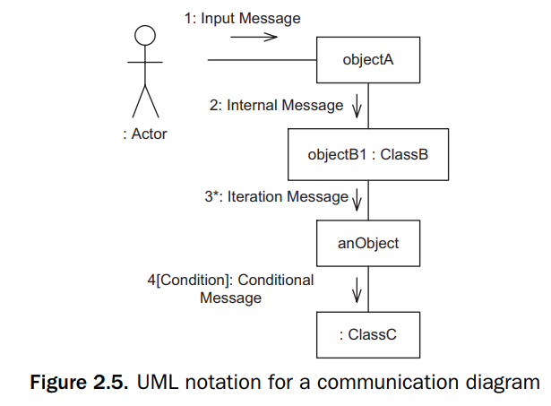
5.1 Interaction diagrams
A communication diagram, which was called a collaboration diagram in UML 1.x, shows how cooperating objects dynamically interact with each other by sending and receiving messages.

Slide 12
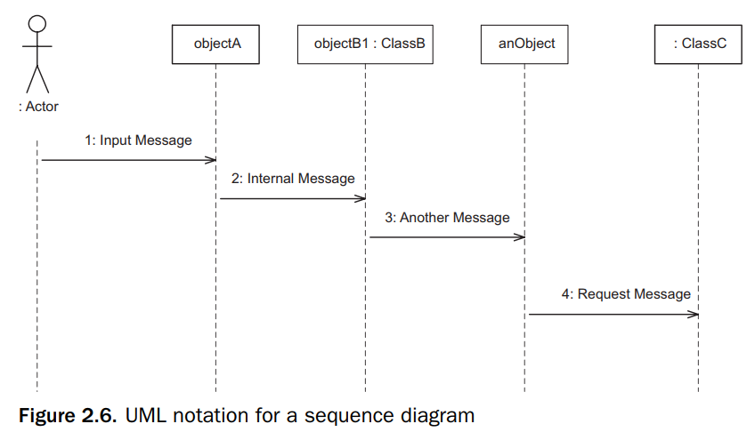
5.2 sequence diagrams
A communication diagram, which was called a collaboration diagram in UML 1.x, shows how cooperating objects dynamically interact with each other by sending and receiving messages.
A sequence diagram is a different way of illustrating the interaction among objects. It depicts object interaction arranged in a time sequence.

Slide 13
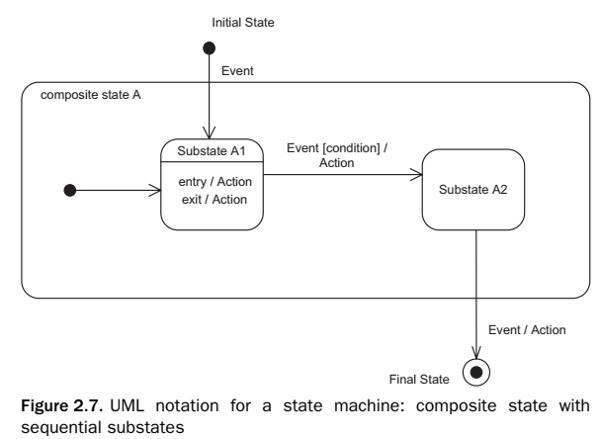
6. State machine diagrams
A state transition diagram is referred to as a state machine diagram. This book use the shorter term statechart.
States are represented by rounded boxes, and transitions are represented by arcs that connect the rounded boxes

Slide 14
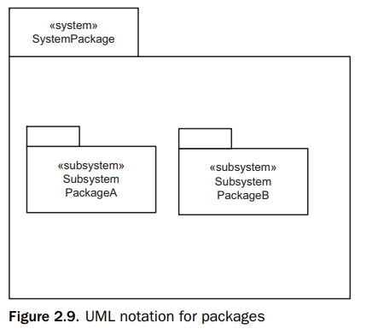
7. Packages
In UML, a package is a grouping of model elements – for example, to represent a system or subsystem. A package is depicted by a folder icon, a large rectangle with a small rectangle attached on one corner.
Packages may also be nested within other packages. Possible relationships between packages are dependency and generalization/specialization relationships.
Packages may be used to contain classes, objects, or use cases.

Slide 15
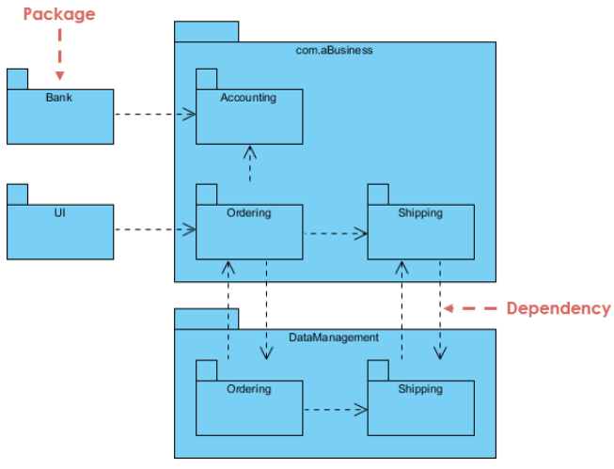
7. Packages

Slide 16
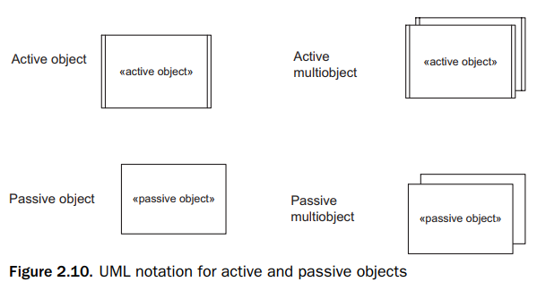
8. Concurrent communication diagrams
In the UML notation, an active object can be used to depict a concurrent object, process, thread, or task.
An active object has its own thread of control and executes concurrently with other objects.
A passive object has no thread of control.
Active objects are depicted on concurrent communication diagrams, which depict the concurrency viewpoint of the system

Slide 17
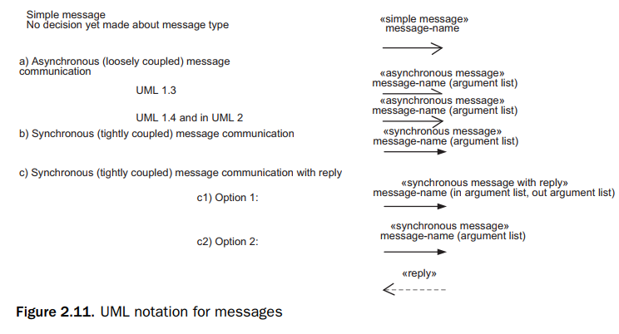
8. Concurrent communication diagrams
Message interfaces between tasks on concurrent communication diagrams are either asynchronous (loosely coupled) or synchronous (tightly coupled).

Slide 18
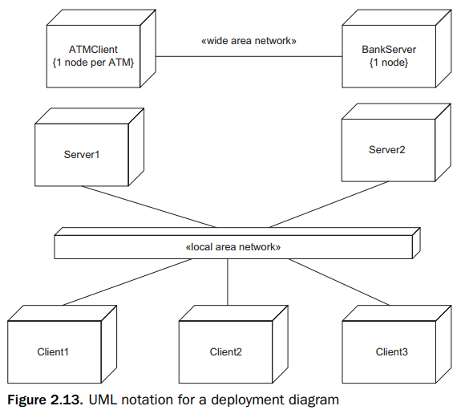
9. Deployment diagrams
A deployment diagram shows the physical configuration of the system in terms of physical nodes and physical connections between the nodes, such as network connections.

Slide 19
10. UML extension mechanisms
UML provides three mechanisms to allow the language to be extended: stereotypes, tagged values, and constraints.

Slide 20
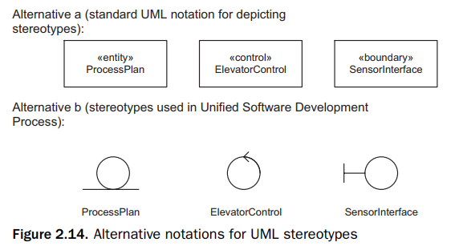
10.1 Stereotype
A stereotype defines a new building block that is derived from an existing UML modeling element but tailored to the modeler’s problem.
Stereotypes are defined in UML or may be defined by modeler (new stereotypes)

Slide 21
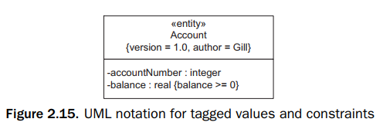
10.2 Tagged Values
A tagged value extends the properties of a UML building block, thereby adding new information.

Slide 22
10.3 Constraints
A constraint specifies a condition that must be true. In UML, a constraint and is an extension of the semantics of a UML element to allow the addition of new rules or modifications to existing rules. Constraints in UML are written by OCL (Object Constraint Language ).

